Slide 1
React Online Marathon

Slide 2
Key

Slide 3

Usually you would render lists inside a component
A key is a special string attribute which helps React to identify components uniquely
key=1
render()
React elements
key=2
render()

Slide 4
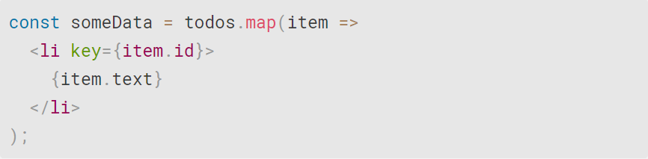
Most often you would use IDs from your data as keys:

Slide 5
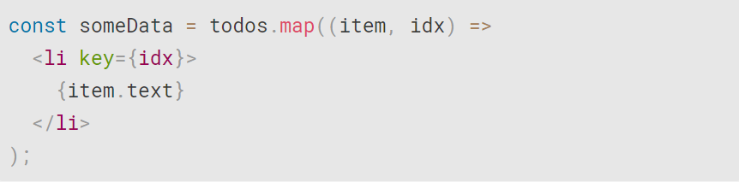
When you don’t have stable IDs for rendered items, you may use the item index as a key as a last resort:
But it is not recommended to use indexes for keys if the order of items may change

Slide 6
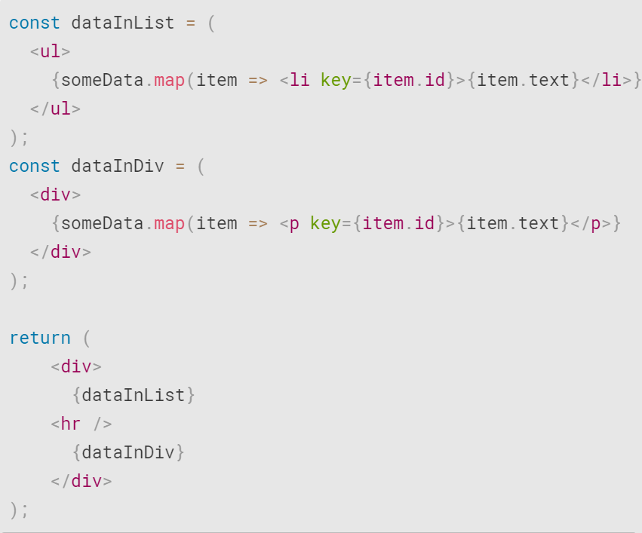
Keys used within arrays should be unique among their siblings - they don’t need to be globally unique

Slide 7
React Online Marathon

Slide 8
State

Slide 9
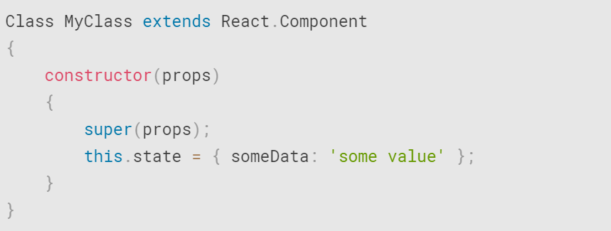
A state is a special instance property and can be defined as an object contains data specific to this component that may change over a lifetime of the component. The state is user-defined:

Slide 10
State should never be updated directly, if we update the state of any component like the following
the webpage will not re-render itself because React State will not be able to detect the changes made
setState() enqueues changes to the component state and tells React that this component and its children need to be re-rendered with the updated state

Slide 11
React Online Marathon

Slide 12
Props

Slide 13
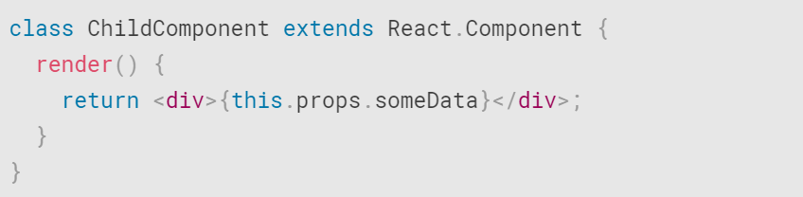
Props are basically kind of object. They used to pass data between components
Whether you declare a component as a class

Slide 14

or a function
it must never modify its own props - props data is read-only

Slide 15
React Online Marathon

Slide 16
Events

Slide 17
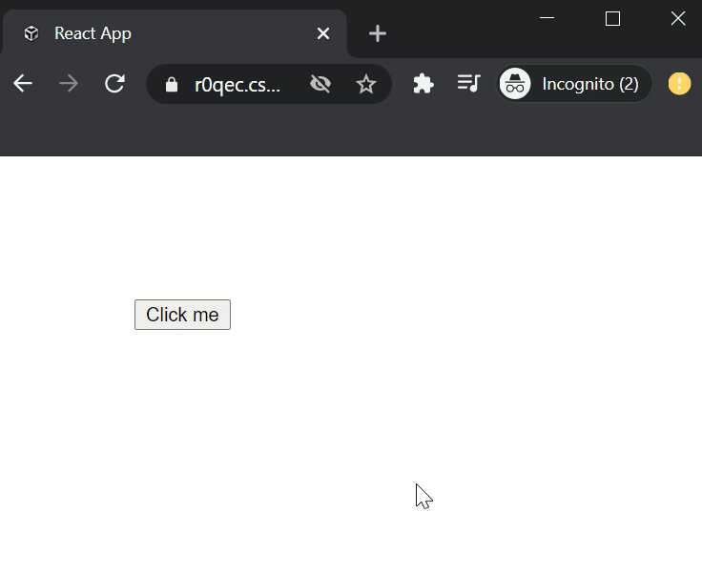
Events аrе thе trіggеrеd rеасtіоns tо sресіfіс асtіоns lіkе mоusе hоvеr, mоusе сlісk, kеy prеss, еtc.

Slide 18
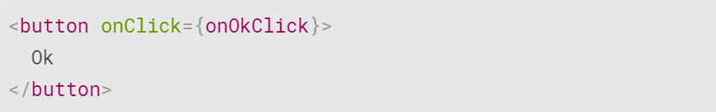
Handling events with React elements is very similar to handling events on DOM elements.
React events are named using camelCase, instead of a lowercase
With JSX you pass a function as the event handler, rather than a string

Slide 19
Event (MouseEvent,…)
handler(e)

Slide 20
Provides a consistent event interface, normalizing browser inconsistencies
Element
Event
Synthetic Event
Component
handler(e)

